Slide 1
Secure data Hiding in Images using steganography
CAPSTONE PROJECT
Presented By
Student Name : Vedant S. Jadhav
College Name & Department : International Institute of Information Technology, E&TC

Slide 2
OUTLINE
Problem Statement
Technology used
Wow factor
End users
Result
Conclusion
Git-hub Link
Future scope

Slide 3
Problem Statement
In the modern digital era, maintaining secure communication presents a significant challenge. Traditional encryption safeguards data but also highlights the presence of confidential information, which may invite scrutiny. This project addresses the need for covert messaging by utilizing steganography—the technique of embedding hidden data within seemingly ordinary images. The proposed solution is a user-friendly GUI application that discreetly encodes text within digital images without any visible alterations, ensuring both secrecy and seamless communication.

Slide 4
Technology used
Libraries:
OpenCV (cv2) – For image processing
OS (os) – For executing system commands
String (string) – Used for handling character mappings (implicitly used)
Tkinter & ttk – Provides the graphical user interface (GUI) components.
NumPy – Supports efficient numerical operations and image data handling.
Pillow – Works with image files for format support and manipulation
Pathlib – Simplifies file path operations in a more readable and object-oriented way
Platform: Python (3.12.3)

Slide 5
Wow factors
Stealth Lock Protection – Secure message encoding and decoding with password authentication, ensuring confidentiality. Advanced error handling prevents unauthorized access while preserving image quality.
ShadowMode Interface – A sleek, dark-themed UI with a color-coordinated design and real-time status updates, making steganography effortless for all users, regardless of technical expertise.
IntelliEmbed Processing – Smart pixel utilization optimizes data embedding while preserving message length, preventing overflow and ensuring seamless message integrity.
Dual-Mode Input – Offers both direct text entry and file-based message loading, with automatic validation to match message size with image capacity, ensuring efficient data handling.
This solution uniquely blends security, usability, and precision, surpassing conventional steganography tools that often trade one advantage for another.

Slide 6
End users
Cipher Enthusiasts – Individuals who prioritize digital privacy and seek secure communication methods.
EdTech Pioneers – Students and educators exploring cybersecurity, cryptography, and secure data transmission.
Cyber Guardians – Security professionals ensuring data protection and stealthy information exchange.
Freedom Defenders – Digital rights activists advocating for secure, private, and censorship-free communication.

Slide 7
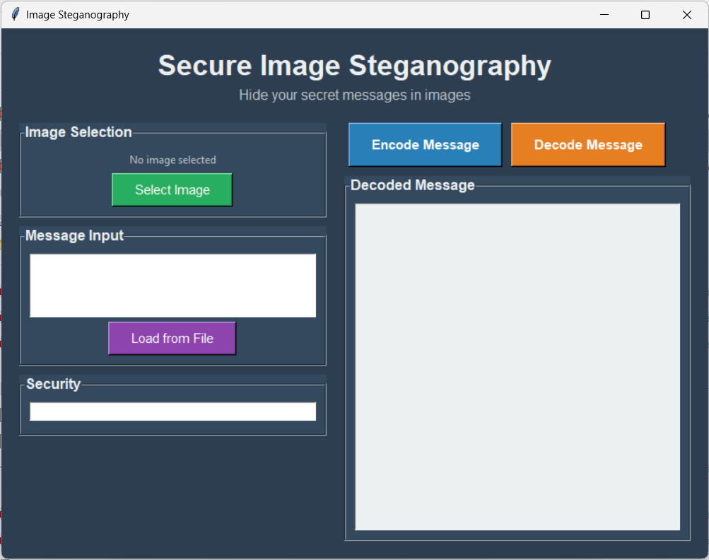
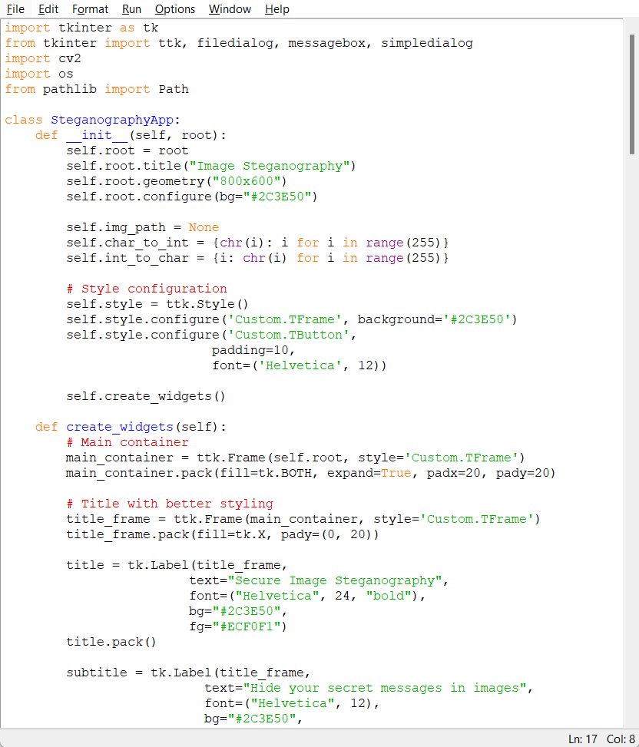
Results
Gui:-
Encryption Code:-

Slide 8
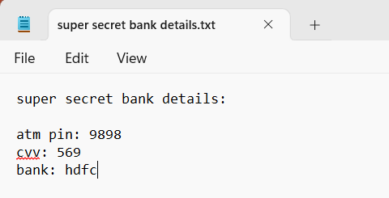
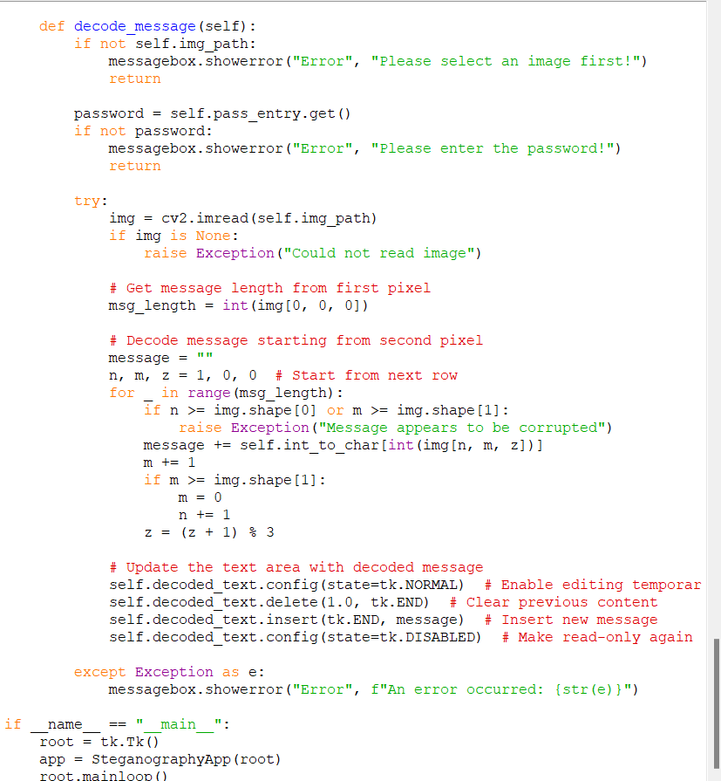

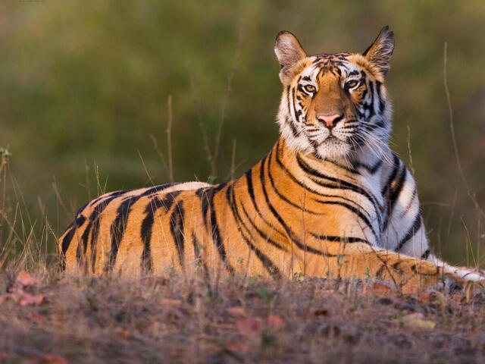
Results
Text file input:
Decryption Code:
Input File:
Output File:

Slide 9
Conclusion
This Image Steganography application offers a secure and user-friendly approach to covert communication by embedding hidden messages within digital images. The project successfully fulfills its objectives through:
Stealth & Protection: Utilizing LSB steganography with password security, ensuring messages remain undetectable to unauthorized viewers.
Ease of Use: Featuring an intuitive dark-themed GUI that simplifies steganography for both technical and non-technical users.
Data Integrity: Preventing message loss with automatic capacity validation and optimized pixel allocation.
By balancing security and usability, this solution empowers privacy-conscious users, educators, and cybersecurity professionals with a reliable method for discreet communication.

Slide 10
GitHub Link
https://github.com/ferroflux/Secure_Data_Hiding_in_Image_Using_Steganography

Slide 11
Future scope(optional)
Fortified Security – Combines AES/RSA encryption with steganography, enabling covert message embedding in images, audio, and video files.
Next-Gen Capabilities – Leverages blockchain for message validation, secure cloud-based image sharing, and AI-driven resistance against steganalysis.
Universal Accessibility – Expands to mobile (Android/iOS) and web platforms, offering seamless real-time collaboration.

Slide 12
THANK YOU

